Slide 1

CHAPTER 7
PROPERTIES OF FUNCTIONS
Copyright © Cengage Learning. All rights reserved.

Slide 2

7.4
Cardinality with Applications to Computability
Copyright © Cengage Learning. All rights reserved.

Slide 3
Cardinality with Applications to Computability
The term cardinal number refers to the size of a set (“This set has eight elements”), whereas the term ordinal number refers to the order of an element in a sequence (“This is the eighth element in the row”). The mathematical definition of cardinal number is based on the use of fingers or tally marks to represent numbers.
For instance, small children often indicate their age by holding up the same number of fingers as the years of their life, and adults frequently use one tally mark to correspond to each vote received by a candidate in an election.

Slide 4
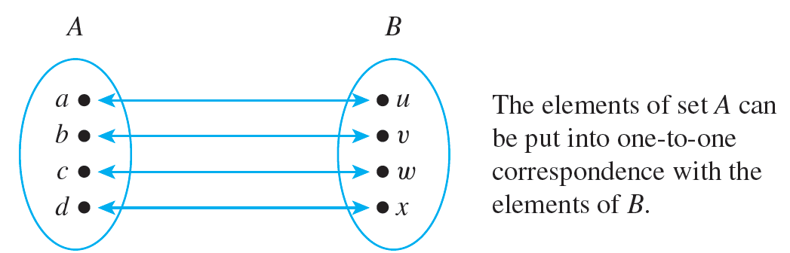
Cardinality with Applications to Computability
A pairing of the elements of two sets is called a one-to-one correspondence. We say that two finite sets whose elements can be paired by a one-to-one correspondence have the same size.
This is illustrated by the following diagram.

Slide 5
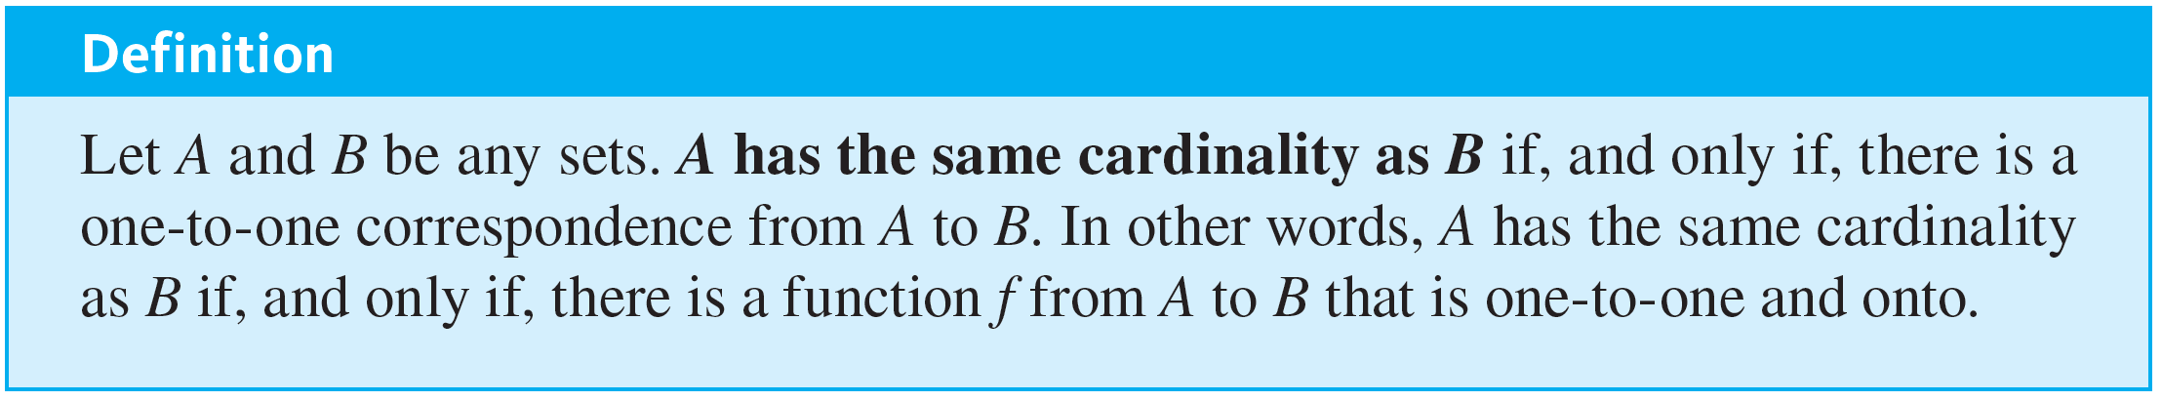
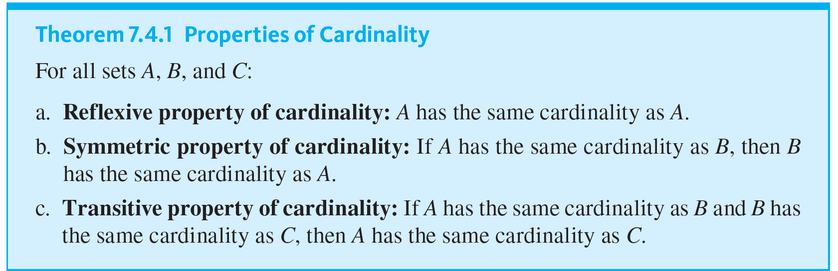
Cardinality with Applications to Computability
The following theorem gives some basic properties of cardinality,

Slide 6
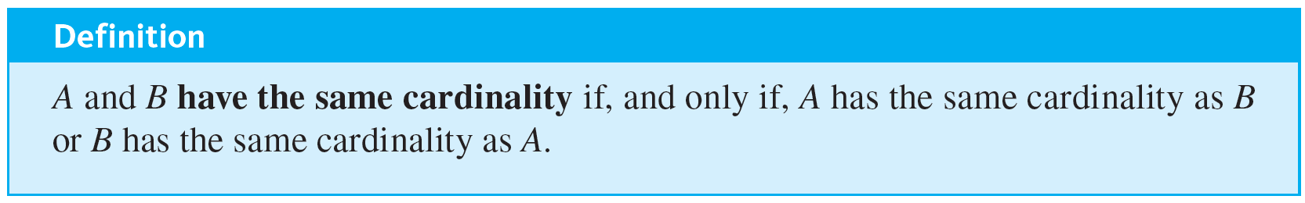
Cardinality with Applications to Computability

Slide 7
Example 7.4.1 – An Infinite Set and a Proper Subset Can Have the Same Cardinality
Let 2Z be the set of all even integers. Prove that 2Z and Z have the same cardinality.

Slide 8
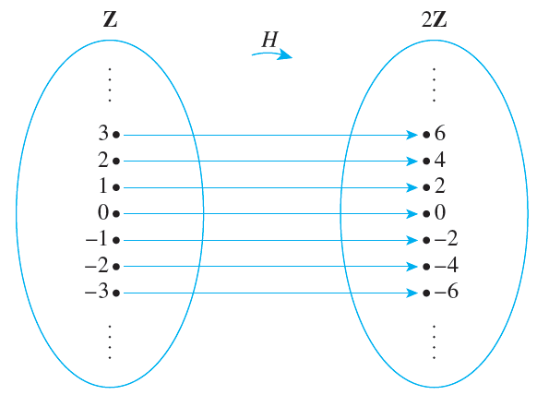
Example 7.4.1 – Solution
Consider the function H from Z to 2Z defined as follows:
H(n) = 2n for each n ∈ Z.
A (partial) arrow diagram for H is shown below.

Slide 9
Example 7.4.1 – Solution
continued
To show that H is one-to-one, suppose H(n₁) = H(n₂) for some integers n₁ and n₂.
Then 2n₁ = 2n₂ by definition of H, and dividing both sides by 2 gives n₁ = n₂. Hence h is one-to-one.
To show that H is onto, suppose m is any element of 2Z. Then m is an even integer, and so m = 2k for some integer k. It follows that H(k) = 2k = m.

Slide 10
Example 7.4.1 – Solution
continued
Thus there exists k in Z with H(k) = m, and hence H is onto.
Therefore, by definition of cardinality, Z and 2Z have the same cardinality.

Slide 11
Countable Sets

Slide 12

Countable Sets
The most basic of all infinite sets is
the set of counting numbers {1, 2, 3, 4, …}. A set A having the same cardinality as this set is called countably infinite.
The reason is that the one-to-one correspondence between the two sets can be used to “count” the elements of A: If F is a one-to-one and onto function from
to A, then F(1) can be designated as the first element of A, F(2) as the second element of A, F(3) as the third element of A, and so forth.

Slide 13
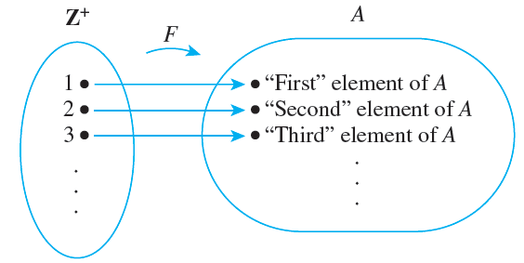
Countable Sets
This is illustrated graphically in Figure 7.4.1 below.
“Counting” a Countably Infinite Set
Figure 7.4.1

Slide 14
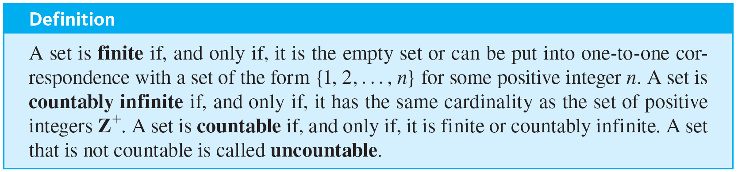
Countable Sets
Because F is one-to-one, no element is ever counted twice, and because it is onto, every element of A is counted eventually.

Slide 15
Example 7.4.2 – Countability of Z, the Set of All Integers
Show that Z, the set of all integers, is countable.

Slide 16
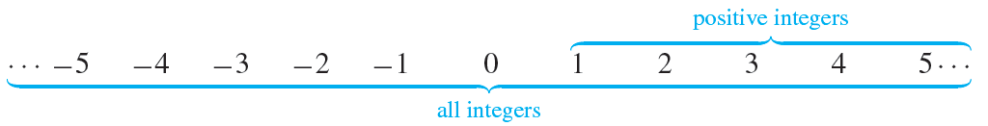
Example 7.4.2 – Solution
The set Z is certainly not finite, so if it is countable, it must be because it is countably infinite. To show that Z is countably infinite, find a function from the positive integers
to Z that is one-to-one and onto.
This seems to contradict common sense because judging from the diagram below, there appear to be more than twice as many integers than there are positive integers.

Slide 17
Example 7.4.2 – Solution
continued
But you were alerted that results in this section might be surprising.
Try to think how you might “count” the set of all integers.
One way is to start in the middle and work outward systematically.

Slide 18
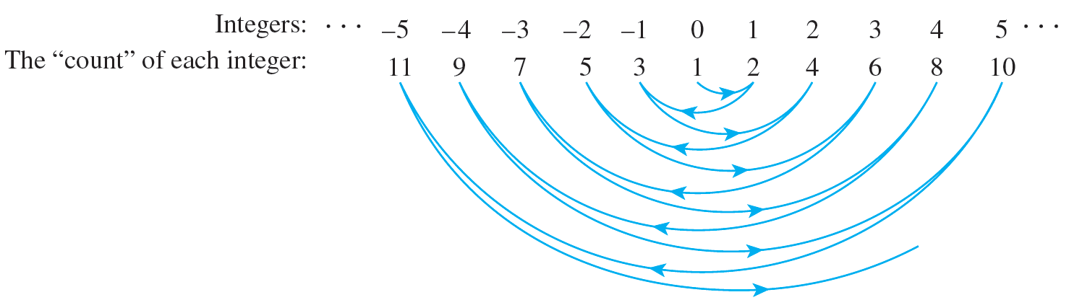
Example 7.4.2 – Solution
continued
Let the first integer be 0, the second 1, the third −1, the fourth 2, the fifth −2, and so forth, as shown in Figure 7.4.2, starting at 0 and swinging outward in back-and-forth arcs from positive to negative integers and back again, picking up one additional integer at each swing.
“Counting” the Set of All Integers
Figure 7.4.2

Slide 19
Example 7.4.2 – Solution
continued
It is clear from the diagram that no integer is counted twice (so the function is one-to-one) and every integer is counted eventually (so the function is onto).
Consequently, this diagram defines a function from
to Z that is one-to-one and onto.
Even though in one sense there seem to be more integers than positive integers, the elements of the two sets can be paired up one for one.

Slide 20
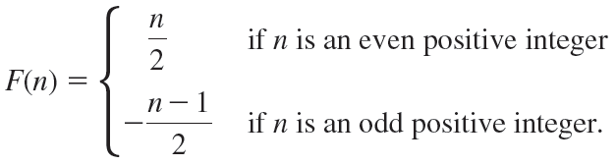
Example 7.4.2 – Solution
continued
It follows by definition of cardinality that
has the same cardinality as Z. Thus Z is countably infinite and hence countable.
The diagrammatic description of the previous function is acceptable as given. You can check, however, that the function can also be described by the explicit formula

Slide 21
The Search for Larger Infinities: The Cantor Diagonalization Process

Slide 22

Example 7.4.4 – The Set of All Positive Rational Numbers Is Countable
Show that
the set of all positive rational numbers, is countable.

Slide 23
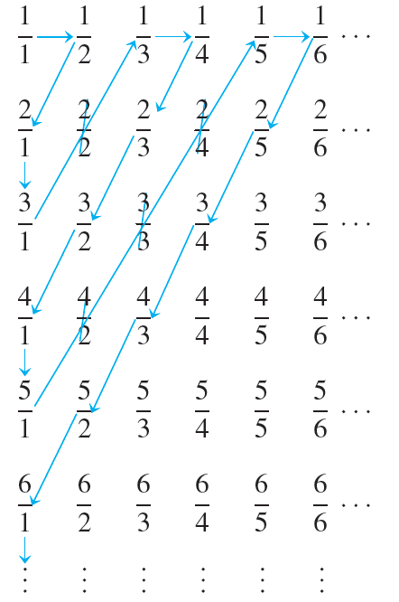
Example 7.4.4 – Solution
Display the elements of the set
in a grid as shown in Figure 7.4.3 below.
Figure 7.4.3

Slide 24




Example 7.4.4 – Solution
continued
Define a function F from
by starting to count at
and following the arrows as indicated, skipping over any number that has already been counted.
To be specific: Set
which was counted already. After that, set

Slide 25
Example 7.4.4 – Solution
continued
Continue in this way, defining F(n) for each positive integer n.
Note that every positive rational number appears somewhere in the grid, and the counting procedure is set up so that every point in the grid is reached eventually. Thus the function F is onto.
Also, skipping numbers that have already been counted ensures that no number is counted twice.

Slide 26

Example 7.4.4 – Solution
continued
Thus F is one-to-one. Consequently, F is a function from
that is one-to-one and onto, and so
is countably infinite and hence countable.

Slide 27
The Search for Larger Infinities: The Cantor Diagonalization Process
In 1874 the German mathematician Georg Cantor achieved success in the search for a larger infinity by showing that the set of all real numbers is uncountable. His method of proof was somewhat complicated, however.
We give a proof of the uncountability of the set of all real numbers between 0 and 1 using a simpler technique introduced by Cantor in 1891 and now called the Cantor diagonalization process.

Slide 28
The Search for Larger Infinities: The Cantor Diagonalization Process
Over the intervening years, this technique and variations on it have been used to establish a number of important results in logic and the theory of computation.
Before stating and proving Cantor’s theorem, we note that every real number, which is a measure of location on a number line, can be represented by a decimal expansion of the form
a₀.a₁a₂a₃…,
where a₀ is an integer (positive, negative, or zero) and for each i ≥ 1, a _{i} is an integer from 0 through 9.

Slide 29
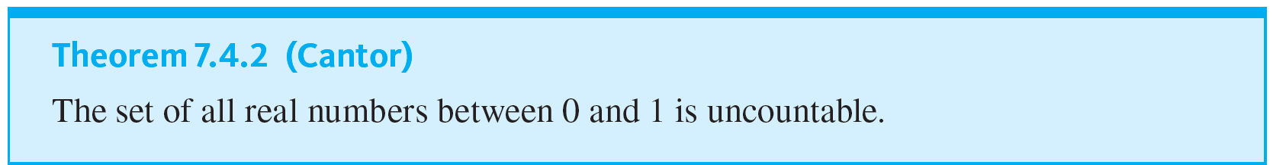
The Search for Larger Infinities: The Cantor Diagonalization Process
Along with demonstrating the existence of an uncountable set, Cantor developed a whole arithmetic theory of infinite sets of various sizes.
One of the most basic theorems of the theory states that any subset of a countable set is countable.

Slide 30
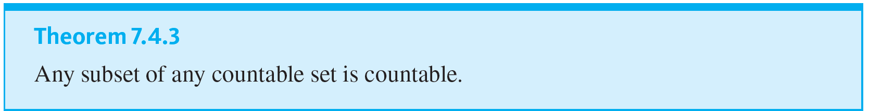
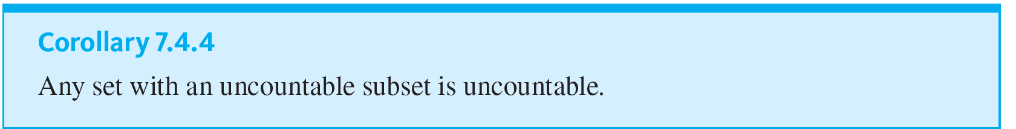
The Search for Larger Infinities: The Cantor Diagonalization Process

Slide 31
Example 7.4.5 – The Cardinality of the Set of All Real Numbers
Show that the set of all real numbers has the same cardinality as the set of real numbers between 0 and 1.

Slide 32

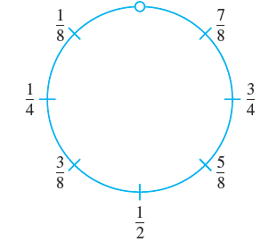
Example 7.4.5 – Solution
Let S be the open interval of real numbers between 0 and 1:
Imagine picking up S and bending it into a circle as shown below.

Slide 33
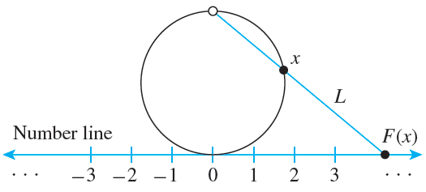
Example 7.4.5 – Solution
continued
Since S does not include either endpoint 0 or 1, the top-most point of the circle is omitted from the drawing.
Define a function F: S → R as follows:
Draw a number line and place the interval, S, somewhat enlarged and bent into a circle, tangent to the number line at the point 0. This is shown below.

Slide 34
Example 7.4.5 – Solution
continued
For each point x on the circle representing S, draw a straight line L through the top-most point of the circle and x, and let F(x) be the point of intersection of L and the number line. (F(x) is called the projection of x onto the number line.)
It is clear from the geometry of the situation that distinct points on the circle go to distinct points on the number line, so F is one-to-one.
In addition, given any point y on the number line, a line can be drawn through y and the top-most point of the circle.

Slide 35
Example 7.4.5 – Solution
continued
This line must intersect the circle at some point x, and, by definition, y = F(x).
Thus F is onto. Hence F is a one-to-one correspondence from S to R, and so S and R have the same cardinality.

Slide 36
Application: Cardinality and Computability

Slide 37
Example 7.4.6 – Countability of the Set of Computer Programs in a Computer Language
Show that the set of all computer programs in a given computer language is countable.

Slide 38
Example 7.4.6 – Solution
This result is a consequence of the fact that any computer program in any language can be regarded as a finite string of symbols in the (finite) alphabet of the language.
Given any computer language, let P be the set of all computer programs in the language. Either P is finite or P is infinite. If P is finite, then P is countable and we are done.
If P is infinite, set up a binary code to translate the symbols of the alphabet of the language into strings of 0’s and 1’s.

Slide 39
Example 7.4.6 – Solution
continued
(For instance, either the seven-bit American Standard Code for Information Interchange, known as ASCII, or the eight-bit Extended Binary-Coded Decimal Interchange Code, known as EBCDIC, might be used.)
For each program in P, use the code to translate all the symbols in the program into 0’s and 1’s.
Order these strings by length, putting shorter before longer, and order all strings of a given length by regarding each string as a binary number and writing the numbers in ascending order.

Slide 40


Example 7.4.6 – Solution
continued
Define a function
by specifying that
F(n) = the nth program in the list for each n ∈
By construction, F is one-to-one and onto, and so P is countably infinite and hence countable.
As a simple example, suppose the following are all the programs in P that translate into bit strings of length less than or equal to 5:
10111, 11, 0010, 1011, 01, 00100, 1010, 00010.

Slide 41
Example 7.4.6 – Solution
continued
Ordering these by length gives
length 2: 11, 01
length 4: 0010, 1011, 1010
length 5: 10111, 00100, 00010
And ordering those of each given length by the size of the binary number they represent gives
01 = F(1)
11 = F(2)
0010 = F(3)
1010 = F(4)

Slide 42
Example 7.4.6 – Solution
continued
1011 = F(5)
00010 = F(6)
00100 = F(7)
10111 = F(8)
Note that when viewed purely as numbers and ignoring leading zeros, 0010 = 00010.
This illustrates why it is important to order the strings by length before arranging them in ascending numeric order because otherwise the values of F would not be uniquely determined.

Slide 43
Example 7.4.7 – The Cardinality of a Set of Functions and Computability
a. Let T be the set of all functions from the positive integers to the set {0, 1, 2, 3, 4, 5, 6, 7, 8, 9}. Show that T is uncountable.
b. Derive the consequence that there are noncomputable functions. Specifically, show that for any computer language there must be a function F from
to {0, 1, 2, 3, 4, 5, 6, 7, 8, 9} with the property that no computer program can be written in the language to take arbitrary values as input and output the corresponding function values.

Slide 44
Example 7.4.7 – Solution
a. Let S be the set of all real numbers between 0 and 1. As noted before, any number in S can be represented in the form
0.a₁a₂a₃…a _{n}…,
where each a _{i} is an integer from 0 to 9. This representation is unique if decimals that end in all 9’s are omitted.
Define a function F from S to a subset of T as follows:
F(0.a₁a₂a₃…a _{n}…) = the function that sends each positive integer n to a _{n}.

Slide 45
Example 7.4.7 – Solution
continued
Choose the co-domain of F to be exactly that subset of T that makes F onto, recalling that T is the set of all functions from
to {0, 1, 2, 3, 4, 5, 6, 7, 8, 9}.
In other words, define the co-domain of F to equal the image of F.
Now F is one-to-one because in order for the functions F(x₁) and F(x₂) to be equal, they must have the same value for each positive integer, and so each decimal digit of x₁ must equal the corresponding decimal digit of x₂, which implies that x₁ = x₂.

Slide 46
Example 7.4.7 – Solution
continued
Thus F is a one-to-one correspondence from S to a subset of T. But S is uncountable by Theorem 7.4.2.
Hence T has an uncountable subset, and so, by Corollary 7.4.4, T is uncountable.

Slide 47
Example 7.4.7 – Solution
continued
b. Part (a) shows that the set T of all functions from
to {0, 1, 2, 3, 4, 5, 6, 7, 8, 9} is uncountable.
But, by Example 7.4.6, given any computer language, the set of all programs in that language is countable.
Consequently, in any computer language there are not enough programs to compute values of every function in T. There must exist functions that are not computable!

